Slide 1
From: Stremersch, Winer and Camacho (2021)
Major Issues Facing Business School
#1 Wrong incentives lead to a lot of research, but possibly of low quality
#2 Less relevant research leads to lower teaching quality
#3 (Associate) deans feel business schools overpay faculty for the research they do
Further issues and elucidation of these issues included in the paper.

Slide 2
From: Stremersch, Winer and Camacho (2021)
Proof from…
234 marketing academics in business schools across the globe surveyed
Sampled from 168 business schools
64% from business schools ranked Top 100 in Financial Times Global MBA ranking
7 deans and 7 associate deans from US & Europe interviewed
from 13 business schools
3 current and 4 former deans, and 5 current and 2 former associate deans
8 external stakeholders interviewed
5 current of past leaders of marketing scholarship (e.g., The Marketing Science Institute)
3 senior marketing practitioners at large multinationals (CMO, CEP, & EVP)

Slide 3
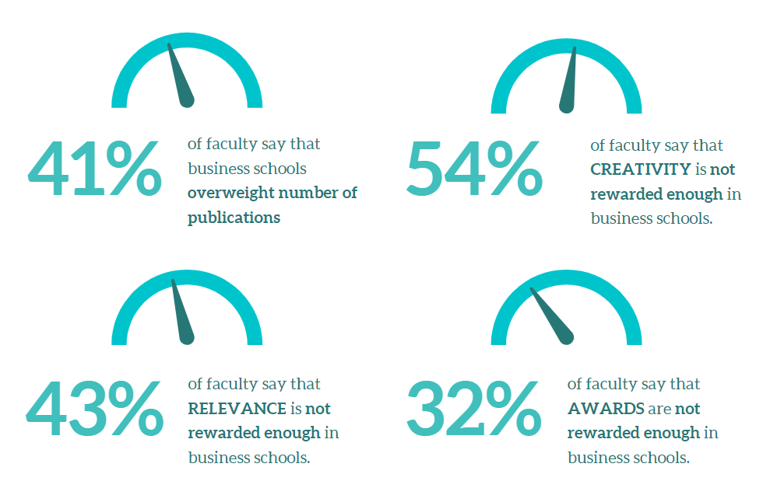
From: Stremersch, Winer and Camacho (2021)
Major Issues Facing Business Schools
#1 Wrong incentives lead to a lot of research, but possibly of low quality
Lower rigor
(“r-quality”)
Lower practical importance
(“q-quality”)
N = 234. Results from our survey of research faculty in business schools across 20 countries (63.7% affiliated with schools ranked in the Top 100 FT Global MBA ranking).
Notes:
*

Slide 4
From: Stremersch, Winer and Camacho (2021)
Major Issues Facing Business Schools
#1 Wrong incentives lead to a lot of research, but possibly of low quality
“I personally view it [a growing reliance on counting] as a very negative trend because people start gaming the citation count.”
Current dean at a U.S. Financial Times top 100 business school
“Now that we have metrics and now that people are scored on those metrics, I think that the system does – it shouldn’t, but it does - put a greater emphasis on those numbers and less on, for example, creativity.”
Current vice-dean at a U.S. Financial Times top 10 business school
“When I look at what's in the journals it strikes me that most of it is pretty irrelevant to what's going on in the world. So, I think that's a huge issue.”
Former dean at a U.S. Financial Times top 30 business school
“[Academic research in business schools] feels like a small set of people speaking to each other about something that nobody cares about. I may be a little harsh here, but it is often not applicable to the kind of problems I see...”
Current senior executive at a cohesion institution that bridges academia and practice

Slide 5
From: Stremersch, Winer and Camacho (2021)
Major Issues Facing Business Schools
#2 Less relevant research leads to lower teaching quality
Research
quantity
No contribution to a business school’s “teaching health”
Rigor
(“r-quality”)
No contribution to a business school’s “teaching health”
Practical importance
(“q-quality”)
Positive contribution to a business school’s “teaching health”
N = 234. Results from our survey of research faculty in business schools across 20 countries (63.7% affiliated with schools ranked in the Top 100 FT Global MBA ranking).

Slide 6
From: Stremersch, Winer and Camacho (2021)
Major Issues Facing Business Schools
#2 Less relevant research leads to lower teaching quality
“…it seems every marketer wants to be a social scientist and wants to stop selling cookies. I mean, there are a lot of marketing scholars that fundamentally do not study marketing topics anymore and just look at topics that are generic social science research topics.”
Current dean of research at a non-U.S. Financial Times top 75 business school
“We have a management department…and I think at this point, there’s maybe two people in there who could be teaching exec ed. And that is where your leadership people should be…and they just can’t do it. At some level, we may kick ourselves out of business.”
Current dean at a U.S. Financial Times top 75 business school

Slide 7
From: Stremersch, Winer and Camacho (2021)
Major Issues Facing Business Schools
#3 (Associate) deans feel business schools overpay faculty for the research they do
“…people come with their hands out all the time. I do not get it. It is just wrong. And I think we get paid really well. We have been historically. And we get things that other university faculty just do not get like guaranteed summers. I mean, talk to someone in public health, right? It has become an absurdity to me, and it’s very unsustainable.”
Current dean at a Financial Times top 75 business school
“Nowadays, it is too hard to get faculty to do things, so you start compensating, paying for everything.”
Current dean at a large public business school in the U.S.
“I think the financing model of the top 100 business schools in the US sooner or later will explode… it is a crisis waiting to happen.”
Current dean of research at non-U.S. Financial Times top 75 business school

Slide 8
From: Stremersch, Winer and Camacho (2021)
Some Solutions We Can Adopt
Incentivize quality more than quantity:
Allocate research funding based on quality
Train scholars on creativity and reward creative, relevant, and impactful work
Develop research metrics that better balance research quantity and research quality
Incentivize research with high practical importance:
Push faculty to practice their profession (as common in medicine or law)
Reward research with high practical impact
Stimulate symbiosis with industry (e.g., consulting and executive education by senior professors)
Align the goals of research faculty with those of the business school:
Promote a high-commitment work environment through teamwork and within-school collaborations
Ensure faculty understands the school’s business model (e.g., showcase its operations & finances)
Expose faculty to ‘day in the life of the dean’ sessions to allow them to see the pressures deans face
Further solutions and elucidation of these solutions included in the paper.

